Slide 1
Research Design and Assessment
MANA 5344

Slide 2
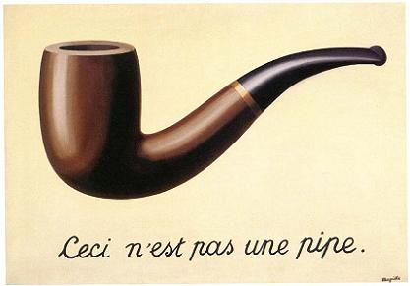

Slide 3
“All models are wrong, but some are useful.”
George Box
All organizational data are models.
P&L – Annual Report
Return on Investment
Inventories
Headcount and Turnover
Employee Attitudes
Cause → Effect estimates are based on organizational data.

Slide 4
Building a Model
Models are subject to the scientific method.
Models are based on assumptions.
Stronger the assumptions the stronger the model.
Assumptions are also models.
Drawing conclusions from models means trade-offs.
Speed / $
Samples
Available data
Cross-section
Time / $$$
Populations
Randomized
Validated data
Longitudinal

Slide 5
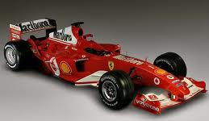


Research Designs
What is the BEST car?

Slide 6
Lies, Damn Lies and…
Systematic Missing Data
Ignoring or not publishing non-significant results
https://www.sciencemag.org/news/2020/01/fda-and-nih-let-clinical-trial-sponsors-keep-results-secret-and-break-law
p-hacking
Parsing and analyzing data to produce p<.05
https://www.wired.com/story/were-all-p-hacking-now/
https://projects.fivethirtyeight.com/p-hacking/
Garden of Forking Paths
Constructing completely reasonable rules for data exclusion, coding, and data analysis that can lead to statistical signiﬁcance—thus, the researcher needs only perform one test, but that test is conditional on the data.
http://www.stat.columbia.edu/~gelman/research/unpublished/p_hacking.pdf
HARKing…
Hypothesizing After Results are Known
Post Hoc Theorizing
https://journals.sagepub.com/doi/abs/10.1207/s15327957pspr0203_4

Slide 7
Red Card Study
Many analysts, one dataset: Making transparent how variations in analytical choices affect results
https://osf.io/gvm2z/
“The new paper’s senior author, psychologist Eric Uhlmann at INSEAD in Singapore, had previously spearheaded a study that gave a single data set to 29 research teams and asked them to use it to answer a simple research question: “Do soccer referees give more red cards to dark-skinned players than light-skinned ones?” Despite analyzing identical data, none of the teams came up with exactly the same answer. In that case, though, the groups’ findings did generally point in the same direction.”

Slide 8
Red Card Study
From a company for sports statistics, we obtained data and profile photos from all soccer players (N = 2053) playing in the first male divisions of England, Germany, France and Spain in the 2012-2013 season and all referees (N = 3147) that these players played under in their professional career.
We created a dataset of 146,000 player '96referee dyads including the number of matches players and referees encountered each other and our dependent variable, the number of red cards given to a player by a particular referee throughout all matches the two encountered each other.

Slide 9
Red Card Study
Player photos were available from the source for 1586 out of 2053 players.
Players skin tone was coded by two independent raters blind to the research question who, based on their profile photo, categorized players on a 5-point scale ranging from very light skin to very dark skin
Additionally, implicit bias scores for each referee country were calculated using a race implicit association test (IAT), with higher values corresponding to faster white | good, black | bad associations. Explicit bias scores for each referee country were calculated using a racial thermometer task, with higher values corresponding to greater feelings of warmth toward whites versus blacks. Both these measures were created by aggregating data from many online users in referee countries taking these tests on Project Implicit

Slide 10
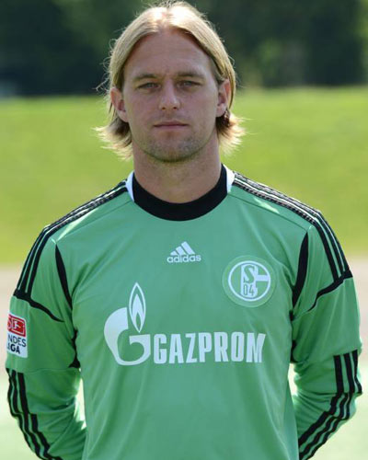
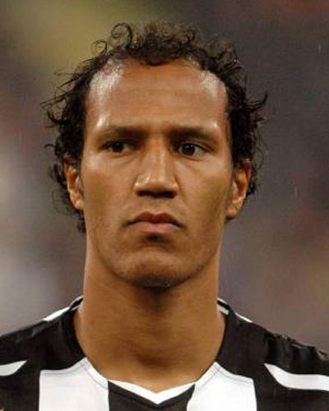
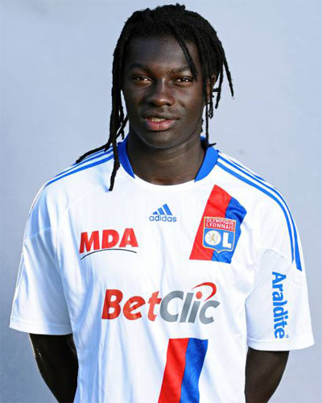
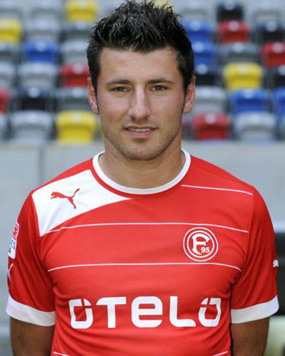


Slide 11
playerShort | \b0 - short player ID\
player | \b0 - player name\
club | \b0 - player club\
leagueCountry | \b0 - country of player club (England, Germany, France, and Spain)\
birthday | \b0 - player birthday\
height | \b0 - player height (in cm)\
weight | \b0 - player weight (in kg)\
position | \b0 - detailed player position \
games | \b0 - number of games in the player-referee dyad\
victories | \b0 - victories in the player-referee dyad\
ties | \b0 - ties in the player-referee dyad\
defeats | \b0 - losses in the player-referee dyad\
goals | \b0 - goals scored by a player in the player-referee dyad\
yellowCards | \b0 - number of yellow cards player received from referee\
yellowReds | \b0 - number of yellow-red cards player received from referee\
redCards | \b0 - number of red cards player received from referee\
photoID | \b0 - ID of player photo (if available)\
rater1 | \b0 - skin rating of photo by rater 1 (5-point scale ranging from \'93very light skin\'94 to \'93very dark skin\'94)\
rater2 | \b0 - skin rating of photo by rater 2 (5-point scale ranging from \'93very light skin\'94 to \'93very dark skin\'94)\
refNum | \b0 - unique referee ID number (referee name removed for anonymizing purposes)\
refCountry | \b0 - unique referee country ID number (country name removed for anonymizing purposes)\
meanIAT | \b0 - mean implicit bias score (using the race IAT) for referee country, higher values correspond to faster white | good, black | bad associations \
nIAT | \b0 - sample size for race IAT in that particular country\
seIAT | \b0 - standard error for mean estimate of race IAT \
meanExp | \b0 - mean explicit bias score (using a racial thermometer task) for referee country, higher values correspond to greater feelings of warmth toward whites versus blacks\
nExp | \b0 - sample size for explicit bias in that particular country\
seExp | \b0 - standard error for mean estimate of explicit bias measure\

Slide 12
Same Data and Research Questions
We use a variety of different regressions. First, we use ordinary least squares with robust standard errors and control for various things such as height, weight, age. We also add in fixed effects for league country, position, club, and referee. In addition, we employ a logistic regression and nonlinear regression to compare with our OLS regressions.
Linear regression, logistic regression
Multilevel Binomial Logistic Regression using bayesian inference.
Correlations and partial correlations.
Multilevel modeling, hierarchical linear models).
Linear probability model
Profile regression, which is a Dirichlet process Bayesian clustering and is implemented in the R package PReMiuM.
For RQ1: ANOVA, Linear Regression For RQ2: Linear Regression
Generalized linear mixed effects models (GLMM), with a logit link function (binary outcome)
Multilevel regression analyses.
Multiple linear regression with a single continuous outcome variable (total red cards) and multiple predictor variables were used to answer question
Zero-inflated poisson (ZIP) regression
glm with poisson distribution
WLS (weighted least squares) estimation
Hierarchical log-linear modeling.
Hierarchical logistic regression was used in both research questions
Bayesian probit regression
hierarchical Bayes model
Linear Regression
A four-level multilevel negative-binomial model.
Tobit regression analysis
The classic OLS, but with dummy variables for each referee and player. Clustered standard errors.
Mixed model logistic regression - both frequentist and Bayesian. Multilevel linear modelling
We used a hierarchical generalized linear model, with a log link function.
Three-level random effects model with Poisson estimation
Poisson Regression
Generalized linear mixed effects modeling

Slide 13
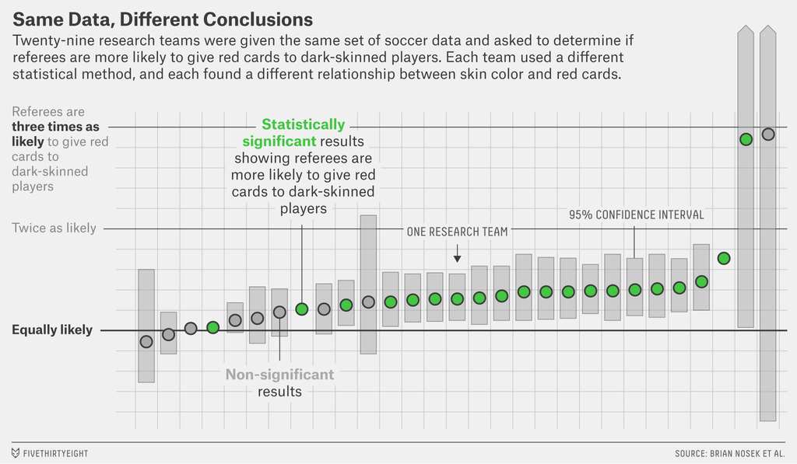
Choices and Methods

Slide 14
Battling Bad Science
John Oliver – Scientific Studies: https://www.youtube.com/watch?v=0Rnq1NpHdmw
Science doesn’t know everything:
https://www.youtube.com/watch?v=uDYba0m6ztE
Battling bad science: http://www.ted.com/talks/ben_goldacre_battling_bad_science

Slide 15
Fundamental Laws of Research
Correlation does mean causation.
Causation requires specific conditions to be met
Explanation requires theory.
Hypotheses tested based on theory
Conclusions are only as strong as your measures.
Findings based on “operationalized” measures
Measures must be the same level of analysis.
“Apples to Apples”
Conclusions are only as representative as your sample.
Populations (all possible cases) vs. Sample (subset of cases)
Strong findings require a strong design
Are you finding the true phenomenon or an “artifact” of your design
The more you can control the stronger your design.
“Everything else held equal”
Confounds are alternative explanations for your research findings.

Slide 16
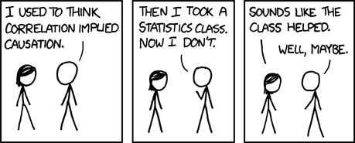

1. Correlation does mean causation.
http://www.businessweek.com/magazine/correlation-or-causation-12012011-gfx.html

Slide 17

Requirements for Causation
What are the requirements to show causation in research?

Slide 18

Requirements for Causation
Temporal ordering (time 1 and time 2)
Measures over time – before and after
Separate measures
Independent variable predicts dependent variable
Observed change
Control for alternate explanations (all of them)

Slide 19
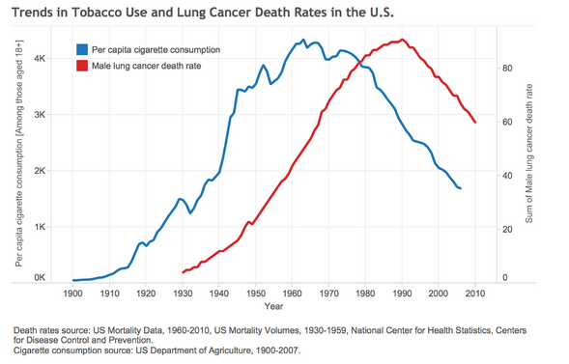
Smoking and Lung Cancer
Smoking
Cancer

Slide 20
Smoking and Lung Cancer
“Smoking”
Gene
Smoking
Cancer

Slide 21
Smoking and Lung Cancer
Surgeon General’s 1963
Advisory Committee
Temporal precedence
Consistency of relationship
Strength of the relationship
Specificity of the association
Coherence
Before / After
Many studies, many measures, many populations
“Dose Response” --- more treatment more effect
One treatment One effect
Theoretical plausibility and consistency

Slide 22
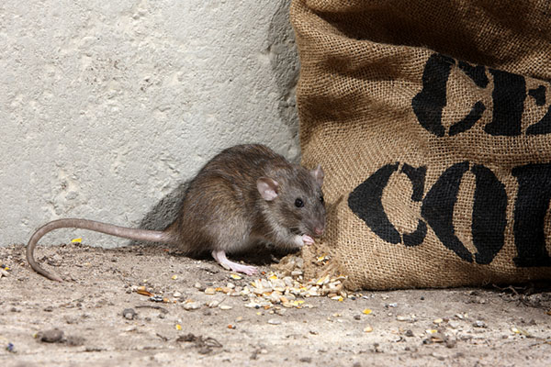
Temporal Ordering
“Post hoc ergo propter hoc”
“After this, therefore because of this”
An ancient logical fallacy….

Slide 23
Understanding Causal Relationships
“Happy workers are productive workers”
Independent Variable
Dependent Variable
Control Variables
Confounding Variables

Slide 24
2. Explanation requires theory.
Theories are casual attributions we use to understand the world around us.
“Stories” we use to understand phenomenon
Logic of causal relationships
Good theories are general and parsimonious.
Good theories are falsifiable.
Occam's Razor – All things being equal a simple explanation is better than a complex one.
No single theory can explain all behavior (particularly human behavior) in every situation.

Slide 25
Role of Theory
Theory turns the “what” into “why”….
Double-blind randomized experiment can tell you that patients who take a certain drug recover more quickly.
But does not tell you why this happens.

Slide 26
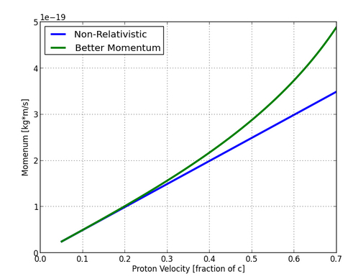
Is Light a Wave Or a Particle?
Light can be modeled as an electromagnetic wave.
James Maxwell “A Dynamic Theory of the Electromagnetic Field” 1865
Light can also be modeled as photon or elementary particle
Albert Einstein 1921 Nobel Prize for photoelectric effect
Arthur Compton 1923 Nobel Prize for “Compton Shift Effect”
It depends….
“Wave-Particle Duality”
http://www.wired.com/2013/07/is-light-a-wave-or-a-particle/

Slide 27
Opening the “Black Box”
Correlation between “high performance” HR practices and firm performance.
Requires a persuasive story based on theory of the actual mechanics through which these practices lead to performance.
HR Practices
Performance

Slide 28
Opening the “Black Box”
Correlation between “high performance” HR practices and firm performance.
Requires a persuasive story based on theory of the actual mechanics through which these practices lead to performance.
HR Practices
The
“Black Box”
Performance

Slide 29
A Theoretical Model
Independent
Variable
(HR Practices)
Dependent
Variable
(Customer Sat)

Slide 30
A Theoretical Model
Independent
Variable
(HR Practices)
Dependent
Variable
(Customer Sat)
Controls
(Size, line of business etc.)

Slide 31
A Theoretical Model
Independent
Variable
(HR Practices)
Mediator
(Attitudes & Motivation)
Dependent
Variable
(Customer Sat)
Controls
(Size, line of business etc.)

Slide 32
A Theoretical Model
Moderator
(Perceptions of Employee Investment)
Independent
Variable
(HR Practices)
Mediator
(Attitudes & Motivation)
Dependent
Variable
(Customer Sat)
Controls
(Size, line of business etc.)

Slide 33
A Theoretical Model
Moderator
(Perceptions of Employee Investment)
Independent
Variable
(HR Practices)
Mediator
(Attitudes & Motivation)
Dependent
Variable
(Customer Sat)
Theory Leads to Hypotheses
A hypothesis is a conjectured statement about the relation between two or more variables.
Tests one thing at a time.
Can be proven (w/ conditions) or disproven
Controls
(Size, line of business etc.)

Slide 34
So now you have a hypothesis…
Support will be demonstrated for the hypothesis only if what conditions are met?
Empirical relationship is observed.
Measures have construct validity.
Relationship is internally valid – other causes are ruled out.
Relationship is externally valid – sample is representative and can be generalized.

Slide 35
3. Conclusions are only as strong as your measures.
Theoretical model
Set of boxes and arrows used to organize your set of hypothesized relationships between variables.
Theoretical arguments to justify each of the linkages.
Measurement model
The specific measures of each variable required to test the hypotheses.
Measures are derived from:
Manipulation (pilot sites vs control sites)
Controls through sample selection
Observation
Psychometrics

Slide 36
Construct Validity
Phenomenon
Measure
Deficiency
Validity
Contamination
Construct validity: the degree to which the scores of a measure capture the underlying phenomenon.

Slide 37
Many Different Ways to Operationalize
Take employee turnover
Total turnover
Full-time / Part-Time / Temps / Contractors?
Exempt/Non-Exempt
Voluntary turnover – what about retirements?
Highly rated employee voluntary turnover
Week / Month / Quarter / Year

Slide 38
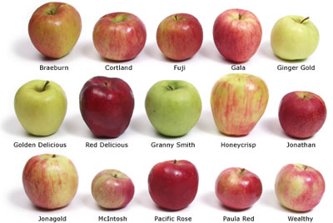
4. Measures must be the same level of analysis.

Slide 39
Levels of Analysis
Departments / SBU’s / Locations
Teams
Individuals
Organizations

Slide 40
5. Conclusions are only as representative as your sample.
External Validity: Does your data have similar characteristics as the population is supposed to represent?
If not – then those differences might influence your results.
The closer you get to the population the more confident you can be in your conclusions.
This is your generalizability.

Slide 41
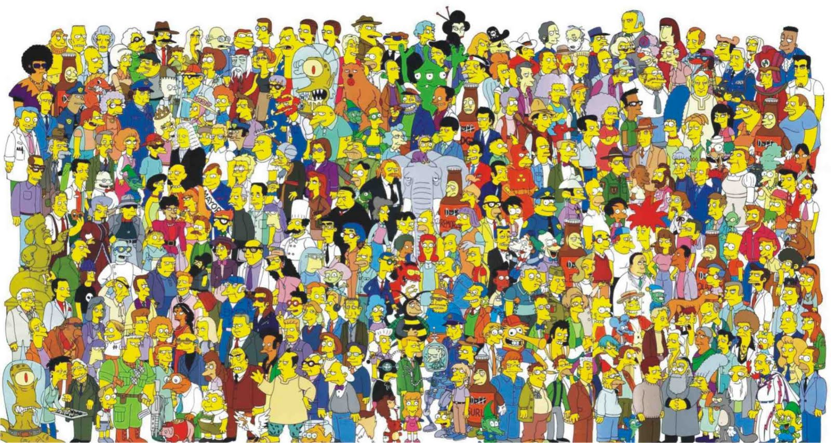
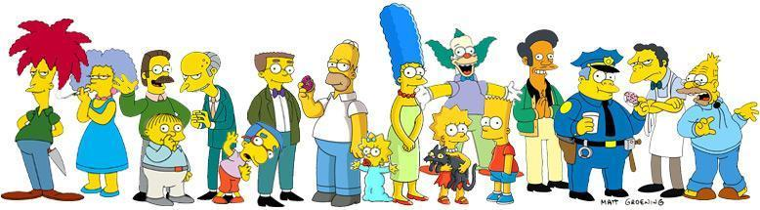
5. Conclusions are only as representative as your sample.
=

Slide 42
6. Strong findings requires a strong design.
Internal Validity: Can the observed relationships be attributed to the true phenomenon or how the research was conducted?
Research is an attempt to explain the variability of a phenomenon by attributing correlation / causation with another variable.
To do so requires eliminating all other potential causes
“Control” is the practice of isolating variables to exclude other potential explanations.

Slide 43
Basic Research Designs
Descriptive
Single variable studies
Cross-Sectional (Between cases)
When you only have data for 1 time period
Analyzes variation between cases
Threats: selection, history, and contamination
Before and After (Longitudinal Within cases)
Data for multiple time periods
Analyzes variation within cases
Threats: maturation, mortality, and regression
Longitudinal (Between cases)
Before and after measures of two groups
Analyzes variation between cases
Threats: selection, history, and contamination

Slide 44
Threats to Internal Validity
Research environment
Subject compliance
Researcher expectancy
Between-cases
Selection
Intra-group history
Contamination
Omitted variables
Longitudinal threats
History / Maturation
Mortality
Testing
Regression
Conditioning
?

Slide 45
Threats to Internal Validity
Research environment
Subject Compliance – Participants guess hypothesis
Researcher expectancy – Researcher influences subjects

Slide 46
Threats to Internal Validity
Between-cases
Selection – Selected subjects have underlying differences
Intra-group history – Something happens to one group and not the other
Contamination – Something happens to both groups unrelated to study
Omitted variables – Poor model specification

Slide 47
Threats to Internal Validity
Longitudinal threats
History / Maturation – Something happens in between measures
Mortality – Subjects drop out of the study between measures
Testing – Act of measurement creates change in subjects
Regression – Measurements tend towards the mean over time
Conditioning – Participants guess the hypotheses

Slide 48
7. The more you can control the stronger your findings.
Remember that causation requires….
Controlling for alternate explanations.
...Beware of the power of unmeasured covariates.

Slide 49
Hypothesized Relationship
Job Satisfaction
Turnover

Slide 50
Hypothesized Relationship
Dependent Variable
Independent Variable
Job Satisfaction
Turnover

Slide 51
Bias from Common Causal Variable
Tenure
Job Satisfaction
Turnover
Overstates the relationship between IV and DV.
Caused by an unmeasured variable that drives both the IV and DV.

Slide 52
Bias from Common Causal Variable
“Confounding Variable”
Tenure
Job Satisfaction
Turnover
Overstates the relationship between IV and DV.
Caused by an unmeasured variable that drives both the IV and DV.

Slide 53
Moderator
Job Alternatives
Job Satisfaction
Turnover
Understates the relationship between IV and DV.
Caused by an unmeasured variable that differentiates the effects of the IV on the DV.

Slide 54
Mediator
Withdrawal
Behavior
Job Satisfaction
Turnover
Overstates the relationship between IV and DV.
Caused by an unmeasured variable that transmits the effects of the IV to the DV.

Slide 55
Full Model
Job Alternatives
Tenure
Job Satisfaction
Withdrawal
Behavior
Turnover

Slide 56
What does all this mean?
Best evidence come from accumulation of work, multiple methods and perspectives.
Meta-Analysis
Best evidence uses best designs and reliable.
Double-blind
Randomized trials
Longitudinal data
Best evidence uses generalizable samples
Large samples – 1,000’s or 1,000,000’s
Appropriate samples
Best evidence is based on significant results and peer review
Statistically significant results
Presenting all results
Best evidence is non-biased
The source matters
Beware of hidden (or not) agendas
Follow the money

Slide 57
Design a Study
Are employee attitudes related to sales and service?
You are the VP of HR for a large electronics retailer with 150 stores around the nation. You want to be able to demonstrate that employee engagement is positively related to customer service and sales. You conduct an employee engagement survey twice a year which is very detailed but anonymous. Your survey vendor provides you will aggregated data at the department level within your stores (cell phones, tvs, computer, electronics, and management). You also have sales data by department for each store measured quarterly and customer satisfaction data measured with a survey of random customers on an on-going basis as well as reports from mystery shoppers which visit the store once a month. What do you do next?
Model
Hypotheses
Measures
Design
Limitations

